Slide 1


FINAL PRESENTAION
MACHINE BIAS IN DIABETES DATASET
SOFTWARE DEVELOPMENT FOR DSAI, 2023

Slide 2




OUR TEAM
Mr. Yordyod Limrostham
Miss Natnarin Phonprapreut
Mr. Jakkrin Srihajak
Mr. Pipat Kumthinkaew
647020016-1
655380002-2
655380003-0
665380009-9

Slide 3

OUR TEACHER
Chitsutha Soomlek
Assistant Professor

Slide 4
MILESTONE 1
CEO OF TIMMERMAN INDUSTRIES

Slide 5

ABOUT DATASSET
DATASET DETAILS
1. This dataset is originally from the National Institute of Diabetes and Digestive and Kidney Diseases. The objective is to predict based on diagnostic measurements whether a patient has diabetes.
2. Several constraints were placed on the selection of these instances from a larger database. In particular, all patients here are females at least 21 years old of Pima Indian heritage.

Slide 6
ABOUT DATASSET
FEATURES DEFINITION
Pregnancies: Number of times pregnant
Glucose: Plasma glucose concentration a 2 hours
in an oral glucose tolerance test
BloodPressure: Diastolic blood pressure (mm Hg)
SkinThickness: Triceps skin fold thickness (mm)
Insulin: 2-Hour serum insulin (mu U/ml)
BMI: Body mass index (weight in kg/(height in m)^2)
DiabetesPedigreeFunction: Diabetes pedigree function
Age: Age (years)
Outcome: Class variable (0 or 1)

Slide 7
ABOUT DATASSET
SOURCES
(A) ORIGINAL OWNERS: NATIONAL INSTITUTE OF DIABETES AND DIGESTIVE AND
KIDNEY DISEASES
(B) DONOR OF DATABASE: VINCENT SIGILLITO (VGS@APLCEN.APL.JHU.EDU)
RESEARCH CENTER, RMI GROUP LEADER
APPLIED PHYSICS LABORATORY
THE JOHNS HOPKINS UNIVERSITY
JOHNS HOPKINS ROAD
LAUREL, MD 20707
(301) 953-6231
(C) DATE RECEIVED: 9 MAY 1990

Slide 8
ABOUT DATASSET
THE QUALITY ISSUES IN THE SELECTED DATASET
1. Dataset has some columns that include missing values.
2. Imbalance data Ex. Number of sampling in each classes class 0 (no diabetes) = 500, 1 (has diabetes) = 268
3. Sampling data were collected from specific 1 country, 1 gender and small size of sample in each class.
4. Some features in the dataset have many outlier values.

Slide 9
ABOUT DATASSET
data before cleaning | 768 row | 9 columns
class 1 (has diabetes)
268
class 0 (no diabetes)
500

Slide 10
ABOUT DATASSET
data after cleaning | 733 row | 9 columns
class 1 (has diabetes)
252
class 0 (no diabetes)
481

Slide 11

GOALS AND SUITABLE
Goal
ARRANGE DATA TO DECREASE BIAS IN REAL DATASET.
2. DEVELOP MODEL FOR PREDICTING FAIRNESS PREDICTED RESULT.
3. DECREASE DATA BIAS WHICH IS ISSUES FROM COLLECTING DATA PROCESSES.
4 .ANALYSE MODEL BIAS.
Missing data
Data imbalance
Data outliers

Slide 12
GOALS AND SUITABLE
Suitable
1.COUNTPLOT : USE FOR CHECKING NUMBER OF CLASSES IN THIS DATASET.
2.BOXPLOT : USE FOR CHECKING OUTLIERS IN DATA.
3. DATAFRAME : SHOWING AND DEAL WITH MISSING VALUES IN EACH FEATURES.
4. CONFUSION MATRIX : SHOWING MODEL PREDICTED RESULTS COMPARING WITH ACTUAL RESULTS.
5. CLASSIFICATION REPORT : PRECISION, RECALL, F1-SCORE, SUPPORT AND ACCURACY.

Slide 13

MODEL
1.NAÏVE BAYES
2. LOGISTIC REGRESSION
3. LINEAR DISCRIMINANT ANALYSIS (LDA)
4. SUPPORT VECTOR MACHINE (SVM)

Slide 14
Summary
our group explored and analyzed the diabetes dataset, and we can deal with some of the features that include missing values (zero value).
We found that the dataset has many features having outlier values.
We chose four models for training and prediction
Naïve Bayes
Logistic regression
Linear Discriminant Analysis
Support Vector Machine.
The imbalance of data made our model get the biased result by classification report of support every outcome of each model, class 0 (which have numbers of sampling data more than class 1) has learned by model more than class 1.

Slide 15
MILESTONE 2
MODEL COMPARISON
CEO OF TIMMERMAN INDUSTRIES

Slide 16
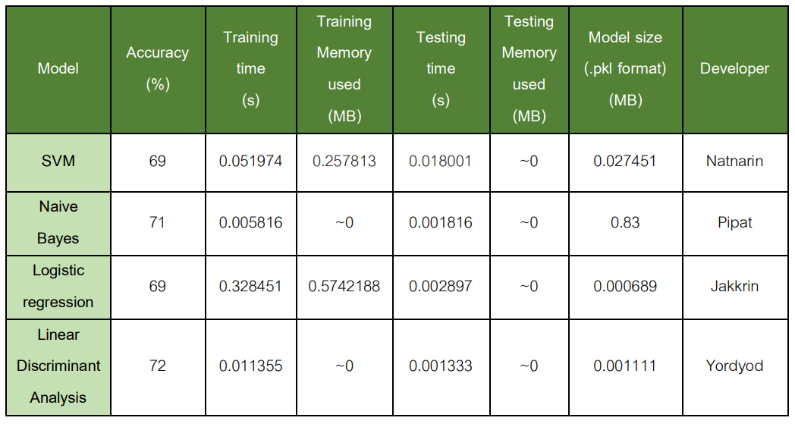
Table 1 : Models comparison results
the LDA model is the best. If we concerned with training and inference cost, Naive Bayes
seems to be the most efficient. If the size of the model is a critical factor, then Logistic regression is the smallest.

Slide 17
MILESTONE 2
METRIC MEASUREMENT
CEO OF TIMMERMAN INDUSTRIES

Slide 18
Our target of model prediction was to predict patients who tend to have diabetes, so we are going to focus in case patients have diabetes but predicted result give no have diabetes. (false negative values).
Our goals have 2 goals including:
1st goal : Arrange data to decrease bias in real dataset to improve the prediction performance.
2nd goal : Analyse model bias to decrease the prediction bias and have fairness predicted result.

Slide 19
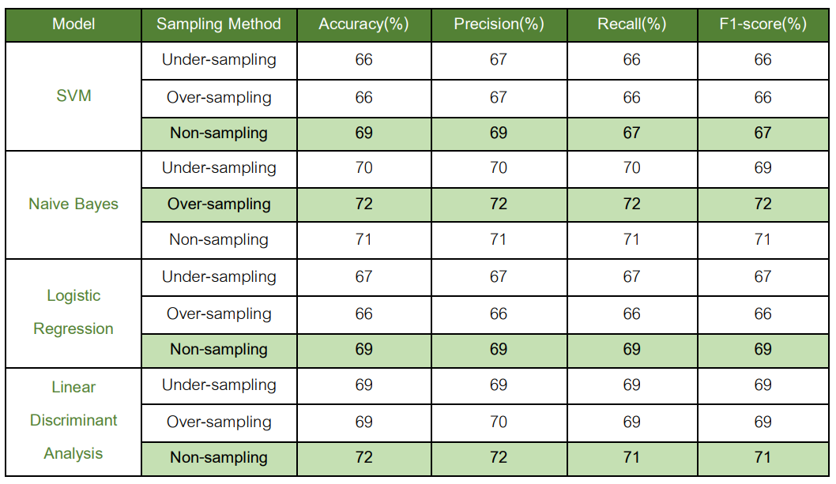
1st goal : Arrange data to decrease bias in real dataset to improve the prediction performance.
Table 2 : Model performance comparison after applied sampling techniques

Slide 20
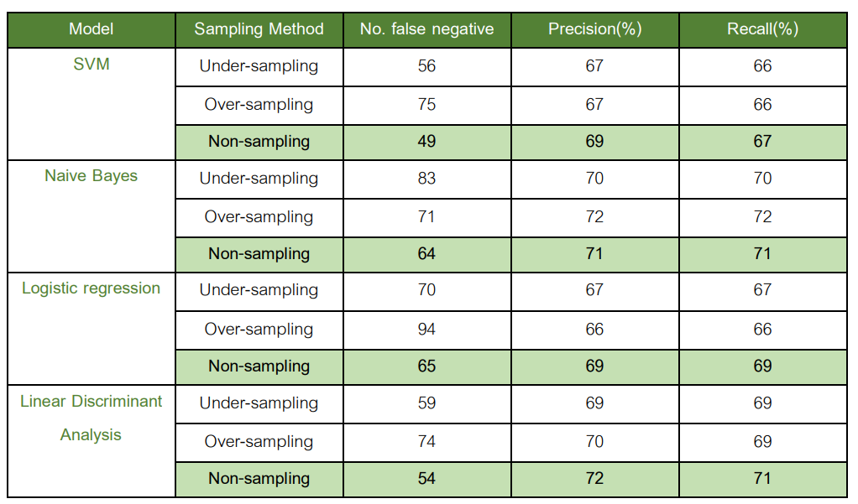
2nd goal : Analyse model bias to decrease the prediction bias and have fairness predicted result.
Table 3 : Model prediction bias comparison after applied
sampling techniques

Slide 21
Summary
Training of non-sampling dataset can give higher performance accuracy from some machine learning models than doing over-sampling or under-sampling with original dataset except Naive Bayes.
The lowest values of false negatives (FN) came from model that training with non-sampling dataset.

Slide 22

MILESTONE 3
MITIGATING BIAS AND FAIRNESS MEASUREMENT IN DATASET

Slide 23
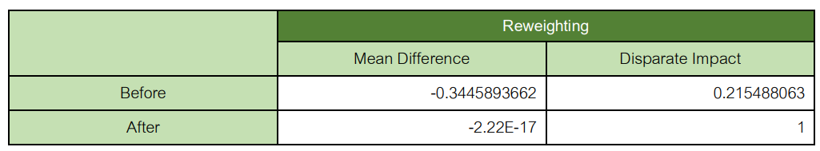
Using Reweighting technique and Fairness measurement
Table 4 : Mean Difference and Disparate Impact before and after apply Reweighting technique
represents comparison of before and after doing Reweighting technique
measure fairness of training dataset by Mean Difference and Disparate Impact
bias was decreasing and more equity in positive outcomes on the protected attribute for the privileged and unprivileged groups.

Slide 24
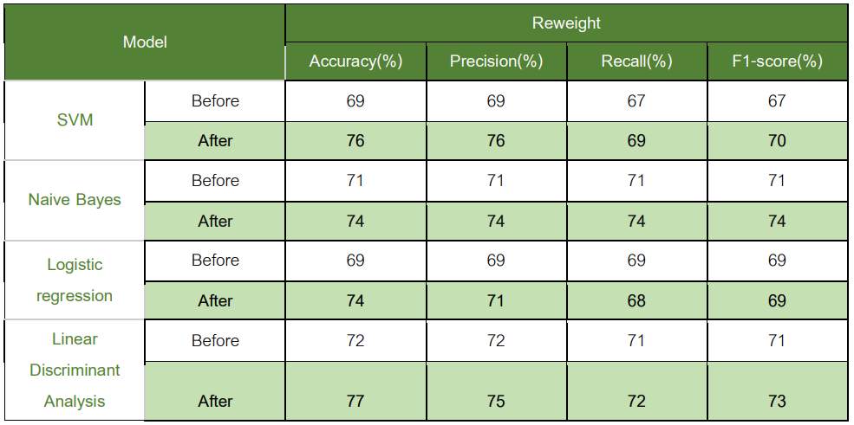
Mitigating bias we use Reweighting technique and compare performance
Table5 : Classification performance comparison before and after applied bias mitigation techniques.
represents the classification performance of individual models
All of the models have
better performance after
applying reweighting
techniques.

Slide 25
Results analysis and possibility improvement
The average models’ accuracy is around 75.25 %.
About fairness, we consider two metrics Mean Difference and Disparate Impact after we are using bias mitigation methods (reweighting).
The values from both fairness metrics (Mean Difference and Disparate Impact) after o reweighting are close to zero and close to 1.
To improve the quality of model.
we suggest that the bias reduction process is very important
we are applying other methods such as data sampling and reweighting.
we suggest experimenting with another various types of machine learning techniques which can suitable to diabetes prediction problem.

Slide 26
Solution or best practices to mitigate the quality issues throughout the system’s life cycle
Recheck that the intelligent to produce result to solve mistakes which do not make more mistakes. (In our case the accepted mistake is that the model predicts a patient don’t have diabetes but in fact they have diabetes . (false negative))
Make sure to check the bias activities that the AI system made not to focus on specific features. (In our case, the system classifies as diabetes for a patient who have volumn of glucose higher than 100)
Prepare and collect data following the necessary of evaluating processes.
Setting up the right operating points (precision and recall points) is also an important practice to check which models performs well.

Slide 27
Solution or best practices to mitigate the quality issues throughout the system’s life cycle
Monitor and check for bias and anomalies of data in the system.
Avoid black-box models.
Define system's goals and measurable metrics that we will use.

Slide 28


TIMMERMAN INDUSTRIES
THANK YOU
FOR YOUR ATTENTION
SOFTWARE DEVELOPMENT FOR DSAI, 2023

